Slide 1
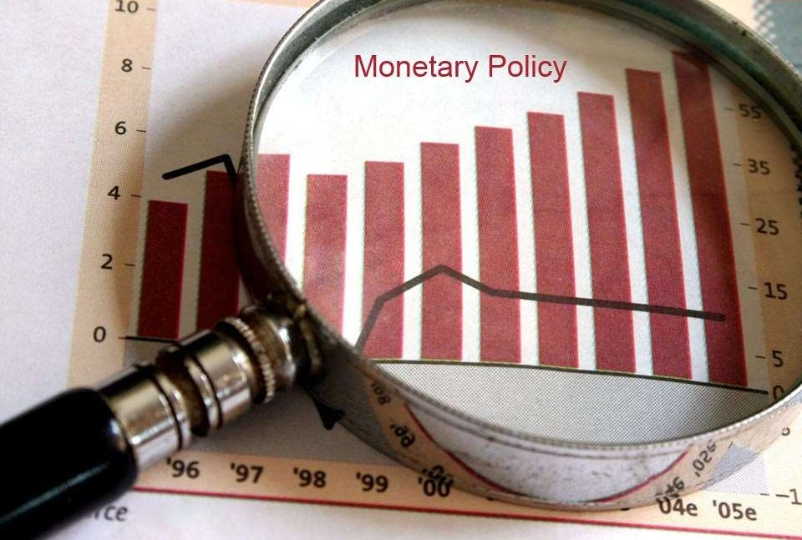
`
Notes:
https://europe.pimco.com/en-eu/resources/education/everything-you-need-to-know-about-bonds

Slide 2
“Monetary policy refers to the action taken by the monetary authorities to control and regulate the demand for and supply of money with a given purpose.”
Notes:
https://www.bankbazaar.com/finance-tools/emi-calculator/monetary-policy.html

Slide 3
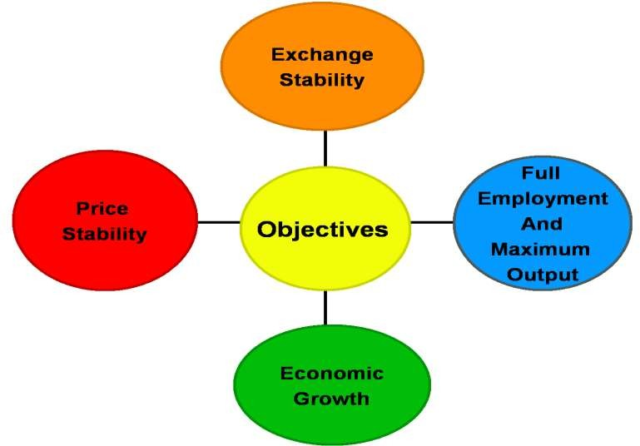

Slide 4

Notes:
https://corporatefinanceinstitute.com/resources/knowledge/economics/expansionary-policy/
https://corporatefinanceinstitute.com/resources/knowledge/economics/contractionary-monetary-policy/

Slide 5
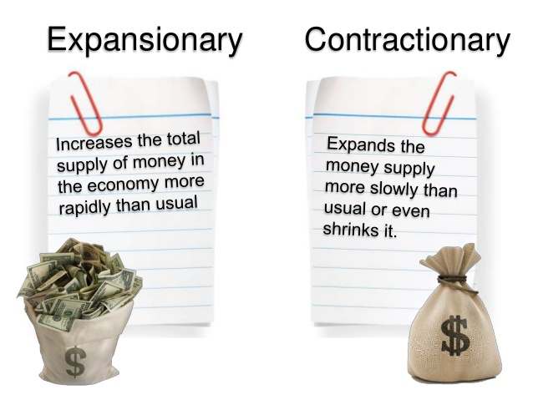

Slide 6
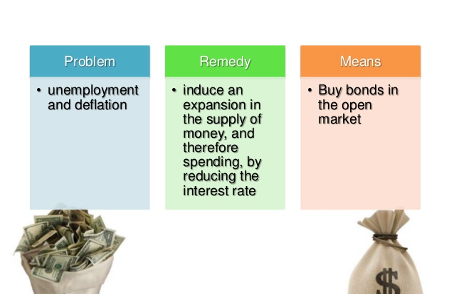
A bond could be thought of as an I.O.U between the lender and borrower that includes the details of the loan and its payments.
Open market -refers to the environment in which bonds are bought and sold between a central bank and its regulated banks
Notes:
In banking and financial economics, the open market is the term used to refer to the environment in which bonds are bought and sold between a central bank and its regulated banks. It is not a free market process.
To intervene in the "business cycle", a central bank may choose to go into the open market and buy or sell government bonds, which is known as open market operations to increase reserves. Open Market Operations are when the central bank buys bonds from other banks in exchange for cheques. These local banks then cash the cheques, which allow them to take money from the central bank. This action thus decreases any credit the local banks may owe to the central bank, and also increases their money supply. This thus increases reserves.
Stated otherwise: To intervene in the "business cycle", a central bank may choose to buy (or sell) government securities from (or to) the banks which it regulates, thereby increasing (or decreasing) the reserves (not deposits) of those banks; the regulated banks must comply with the buy & sell orders of the central bank. This process is known as open market operations. For example, a central bank may command its regulated banks to sell government bonds or bills to the central bank, which pays with cheques or electronic transactions which are cashed by these banks, moving money from the central bank to the bank reserves (not deposits) of the regulated banks.

Slide 7
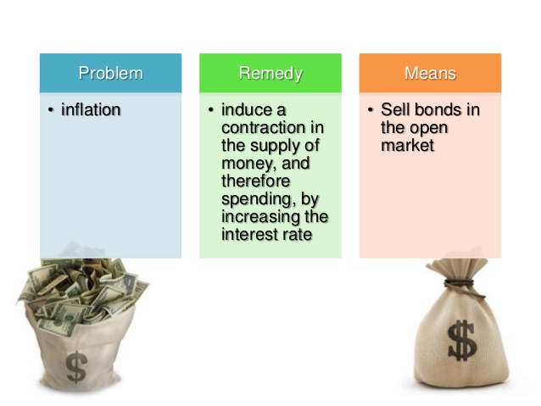
When a central bank buys bonds, money is flowing from the central bank to individual banks in the economy, increasing the money supply in circulation.
When a central bank sells bonds, then money from individual banks in the economy is flowing into the central bank—reducing the quantity of money in the economy.

Slide 8
Expansionary Policy
What is Expansionary Policy?
Expansionary policy is a type of macroeconomic policy that is implemented to stimulate the economy and promote economic growth. Expansionary policies are used by central banks in times of economic downturns to reduce the adverse impact on the economy.

Slide 9
Types of Expansionary Policy
There are two main types of expansionary policy – fiscal policy and monetary. Expansionary monetary policy focuses on increased money supply, while expansionary fiscal policy revolves around increased investment by the government into the economy.
1. Expansionary Monetary Policy
Expansionary monetary policy aims to spur economic growth through increased liquidity. Increased money supply promotes economic growth. It occurs because corporations and individuals look to capitalize upon the easily available funds by undertaking greater investments, expanding operations, and increasing consumption.
There are different ways central banks can achieve the goal of increased liquidity. One method is to lower lending rates. Central banks provide loans to commercial banks at a particular rate.
When the rate is lowered, there is more demand for funds by the commercial banks and their clients. Lower rates discourage savings and encourage consumption and investment, which promotes economic growth.
A second way through which central banks can increase the money supply is by reducing the reserve requirement imposed on commercial banks. Commercial banks must hold a certain portion of funds they receive in the form of deposits as reserves.
Lower reserve requirements mean that more funds are made available to those looking to borrow.
Central banks also engage in open market operations to increase liquidity. By purchasing securities, such as government bonds in the market, they inject additional funds into the economy.

Slide 10
2. Expansionary Fiscal Policy
Fiscal policies are enacted directly by the government rather than central banks.
Governments aim to stimulate the economy by directly engaging in expansionary activities through increased spending.
The increased spending is typically through building infrastructure projects. Other methods, such as transfer payments, tax cuts, and rebates, are aimed at ensuring that funds are available more easily to the public.

Slide 11
Effects of Expansionary Policy
1. Increased money supply – higher consumption and greater economic growth
Expansionary policies increase the availability of funds, which, in turn, leads to increased consumption and greater economic growth. Because companies have more funds available to them, they increase production, which then increases the demand for all factors of production, including human capital.
2. Greater need for human capital – lower unemployment
The greater need for human capital leads to lower unemployment. The lower levels of unemployment lead to a greater demand for products as consumption increases. It leads the economy into a virtuous cycle.
Over time, the increased money supply and the abundance of funds mean that the value of currency drops, and inflation increases. It is important that inflation rates do not go beyond a certain threshold. To ensure that rates are kept within a certain range, contractionary policies may be deployed.
Inflation and interest rates move in the same direction. Expected and actual inflation rates dictate to central banks whether to increase or decrease rates. Low inflation rates indicate to central banks that a rate cut is needed and vice versa.

Slide 12
Risks of Expansionary Policy
1. Overextended debt levels
One of the risks of expansionary policy is debt being overextended. Because funds are readily available, both corporations and individuals move to take advantage of lower rates by incurring greater debt. High levels of debt are not sustainable over a long period and may lead to damaging results if not analyzed carefully.
2. High inflation rates
The most prominent risk associated with an expansionary policy is the risk of high inflation. Central banks have a target inflation level, which is considered ideal for steady inflation growth.
If unchecked, inflation can spiral out of control and lead to a situation that is called hyperinflation, which can have a severe adverse impact on the economy. In periods of high inflation, prices of items increase faster than wages do, and real wages along with the standard of living falls.
High inflation also means that real interest earned on savings falls rapidly, and the currency will depreciate rapidly. Countries with high inflation rates, such as Venezuela, South Sudan, and Congo, are facing severe economic depressions.

Slide 13
Contractionary Monetary Policy
What is a Contractionary Monetary Policy?
A contractionary monetary policy is a type of monetary policy that is intended to reduce the rate of monetary expansion to fight inflation. A rise in inflation is considered the primary indicator of an overheated economy, which can be the result of extended periods of economic growth. The policy reduces the money supply in the economy to prevent excessive speculation and unsustainable capital investment.

Slide 14
A contractionary monetary policy is generally undertaken by a central bank or a similar regulatory authority. The central bank usually sets a target for the inflation rate and uses the contractionary monetary policy to meet the target.
Tools for a Contractionary Monetary Policy
Every monetary policy uses the same set of tools. The main tools of monetary policy are short-term interest rates, reserve requirements, and open market operations. A contractionary monetary policy utilizes the following variations of these tools:
1. Increase the short-term interest rate (discount rate)
Interest rates are the primary monetary policy tool of a central bank. Commercial banks can usually take short-term loans from the central bank to meet short-term liquidity shortages. In return for the loans, the central bank charges the short-term interest rate.
In order to reduce the money supply, the central bank can opt to increase the cost of short-term debt by increasing the short-term interest rate. The increase in interest rates will also affect consumers and businesses in the economy as commercial banks will raise the interest rates they charge their clients.
2. Raise the reserve requirements
Commercial banks are obliged to hold the minimum amount of reserves with the central bank and a bank’s vault. A rise in the required reserve amount would decrease the money supply in the economy.
3. Expand open market operations (sell securities)
The central bank is involved in open market operations by selling and purchasing government-issued securities. The central bank can reduce the money circulated in the economy by selling large portions of the government securities (e.g., government bonds) to investors.

Slide 15
Effects of a Contractionary Monetary Policy
A contractionary monetary policy may result in some broad effects on an economy. The following effects are the most common:
1. Reduced inflation
The inflation level is the main target of a contractionary monetary policy. By reducing the money supply in the economy, policymakers are looking to reduce inflation and stabilize the prices in the economy.
2. Slow down economic growth
Reducing the money supply usually slows down economic growth. As the money supply in the economy decreases, individuals and businesses generally halt major investments and capital expenditures, and companies slow down their production.
3. Increased unemployment
An unwanted side effect of a contractionary monetary policy is a rise in unemployment. The economic slowdown and lower production cause companies to hire fewer employees. Therefore, unemployment in the economy increases.

Slide 16
Quantitative Tools of Monetary
Quantitative tools also known as the Reserve Bank of India’s general tools are instruments linked to the quantity and volume of money, as the name implies. These instruments are used to regulate the total amount of money and volume of bank credit in the economy. Cash Reserve Ratio, Statutory Liquidity Ratio, Open Market Operations and Repo Rate are a few examples of Qualitative tools of Monetary Policy.
What are Quantitative tools/Quantitative instruments?
The Quantitative tools are also known as the Reserve Bank of India’s general tools.
These instruments are linked to the quantity and volume of money, as the name implies.
These instruments are used to regulate the total amount of money and volume of bank credit in the economy.
These are indirect instruments that are used to influence the amount of credit available in the economy.
For instance, reducing the Statutory Liquidity Rate (SLR) will increase the liquidity of money in the market and increasing the SLR will decrease the liquidity.

Slide 17
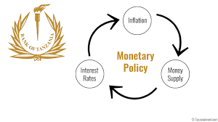
INSTRUMENTS OF MONETARY POLICY
General Credit Control Measures
Bank Rate
CRR
Open Market Operations
SLR
Repo Rate (Repurchase operation rate)
Reverse Repo Rate

Slide 18

General Measures:
1. Bank Rate Policy:
The rate at which central bank lends money to the commercial banks.

Slide 19
The central bank can change this rate- increase or decrease- depending on whether it wants to expand or reduce the flow of credit from commercial banks.
Current Bank rate (10th May 2022): 4.25 %
Notes:
Bank rate does not require a security
Repo rate requires a collateral security

Slide 20
2. Cash Reserve Ratio:
Also termed as Statutory Reserve Ratio (SRR)
It is the percentage of total deposits which commercial banks are required to maintain in the form of cash reserve with the central bank.
Objective of CRR is to prevent shortage of cash for meeting the cash demand by depositors.

Slide 21
By changing CRR, the central bank can change the money supply overnight.
When contractionary monetary policy is to be adopted , then the central bank raises the CRR
When expansionary monetary policy is to be adopted then central bank cuts down the CRR
CRR till 05th May 2022 was 4.40 %

Slide 22
3. Open Market Operations
Open Market Operations is the sale and purchase of government securities by the central bank of the country.

Slide 23
When central bank decides to pump money into circulation, it buys back the government securities, bonds.
When it decides to reduce money in circulation, it sells the government bonds and securities.

Slide 24
How the sale of government bonds affects the supply of credit?
1. Purchase of govt. securities reduces deposits with commercial banks and their cash reserves which leads to decreased credit creation capacity of the banks.

Slide 25
4. Statutory Liquidity Ratio:
Under SLR, the commercial banks are required to maintain a certain percentage of their total daily demand and time deposits in the form of liquid assets.
SLR as of 5th May 2022 18%

Slide 26
5. Repo rate: RBI buys securities from banks and thereby provides funds to the banks. The rate of interest at which the RBI lends money to the bank is the repo rate. (as of 5th May 2022is 4.40%)
6. Reverse repo rate: is the rate at which the banks can buy securities or deposit money with the RBI (as of 5th May 2022 is 3.35%)

Slide 27
Quantitative Tool | What happens if increased | What happens if its decreased
Bank Rate | Money Supply decreases | Money Supply increases
Statutory Liquidity Ratio (SLR) | Money Supply decreases | Money Supply increases
Cash Reserve Ratio (CRR) | Money Supply decreases | Money Supply increases
Repo rate | Money Supply decreases | Money Supply increases
Reverse Repo Rate | Money Supply decreases | Money Supply increases
Open Market Operation (OMO) | Selling securities will decrease money supply | Buying securities will increase money supply

Slide 28
Significance of Quantitative tools
Quantitative tools are linked to the quantity and volume of money, as the name implies.
It is used to regulate the total amount of money and volume of bank credit in the economy.
Quantitative tools are indirect instruments that are used to influence the amount of credit available in the economy.
It affects the level of aggregate demand through the supply of money, cost of money and availability of credit.
Limitations of Quantitative tools
Frequent changes in policy rates can cause speculations among the banks leading to poor transmission of monetary policy.
The usage of quantitative tools alone can’t achieve the desired situation in an economy as there are many other parameters deciding money supply.

Slide 29
Qualitative Tools of Monetary Policy
Qualitative Tools of Monetary Policy is a set of instruments used by the Reserve Bank of India (RBI) which discriminates the use and allocation of credit to different sectors of the economy. The qualitative tools are also known as Selective Tools of Monetary Policy.

Slide 30
What are Qualitative tools
Qualitative instruments are selective instruments of the RBI's monetary policy.
These instruments are used to distinguish between different types of credit, such as preferring export over import or essential credit supply over non-essential credit supply.
Both borrowers and lenders are affected by this strategy.
These instruments have an impact on how credit is used in various sectors. For example, the RBI can set upper limits on how much money banks can lend to specific sectors of the economy.
The amount of money in circulation is unaffected. The available funds are simply directed in a certain direction.

Slide 31
Types of Qualitative tools
Change in Marginal Requirement
The term "margin" refers to the percentage of a loan that is not offered or financed by the bank.
A change in the loan size can be caused by a change in the marginal requirement.
This device is used to boost credit supply for necessary sectors while discouraging it for non-essential ones.
This can be accomplished by raising the marginal of unneeded sectors while lowering the marginal of other sectors in need.
If the RBI believes that additional credit should be available to the agricultural sector, the margin will be reduced, and 80-90 per cent of the loan will be available.
For Instance, if the marginal requirement for the agricultural sector is 10% and if someone pledges collateral worth 10 crores for a loan of 10 crores, then the sanctioned loan would be a maximum of 9 crores.
On the other hand, if the automotive sector has a marginal requirement of 20%, for the same collateral and loan the sanctioned amount will be 8 crores.
Regulation of Consumer Credit
Consumer credit supply is regulated by the instalment of sale and hire purchase of consumer goods.
Features such as instalment amount, down payment, loan period, and so on are all pre-determined, which aids in the control of credit and inflation in the country.
For Instance, for a home loan, the RBI can set a minimum downpayment limit of 15%. Therefore for a home loan of 1 crore, Rs. 15 lakhs must be paid as a downpayment and avail 85 lakhs as a loan.

Slide 32
Rationing of Credit
The Reserve Bank of India sets a credit limit for commercial banks. The quantity of credit accessible to any commercial bank is limited.
The higher credit limit might be set for certain objectives, and banks must adhere to it.
This reduces the bank's credit exposure to unfavourable industries. This device also regulates bill rediscounting.
For Instance, the banks might be instructed by the RBI not to lend to traders of Onion and Potato in spite of having eligibility and collateral pledging capacity. This is to ensure there is no hoarding of essential commodities by using bank loans.
Moral Suasion
Moral suasion refers to the RBI's recommendations to commercial banks that aid in the restraint of credit during inflationary periods.
The Reserve Bank of India (RBI) exerts pressure on the Indian banking system without taking any concrete steps to ensure compliance with the rules.
Commercial banks are informed of the RBI's expectations through monetary policy.
Under moral suasion, the RBI can offer orders, recommendations, and suggestions to commercial banks to reduce loan supply for speculative purposes.
For Instance, the Governor of RBI making a press statement that the reduction in repo rates have not been transferred to the consumers. This will nudge the banks to reduce their interest rates.
Direct Action
The central bank (RBI) can punish and impose sanctions on banks for not following the guidelines provided under the monetary policy.
For Instance, the imposition of the Prompt Corrective Action Framework is one such Direct Action measure.

Slide 33
Parameter | Quantitative Tools | Qualitative Tools
Tools | Bank Rate Statutory Liquidity Ratio (SLR) Cash Reserve Ratio Open Market Operation (OMO) Repo rate Reverse Repo Rate | Marginal requirements Regulation of consumer credit Rationing of Credit Moral Suasion Direct Action
Impact | Indirect in nature as any change in these tools may not transmit to the consumer immediately or directly. | Direct in nature as any changes are directly impacting the consumers as the case of requirement of a down payment.
Reach | The reach of Quantitative tools is general. They affect money supply in the entire economy and all sectors be it housing, automobile, manufacturing- everything. | The reach of Qualitative tools is selective. It can affect money supply in a specific sector of the economy like automobile or agriculture.

